Slide 1
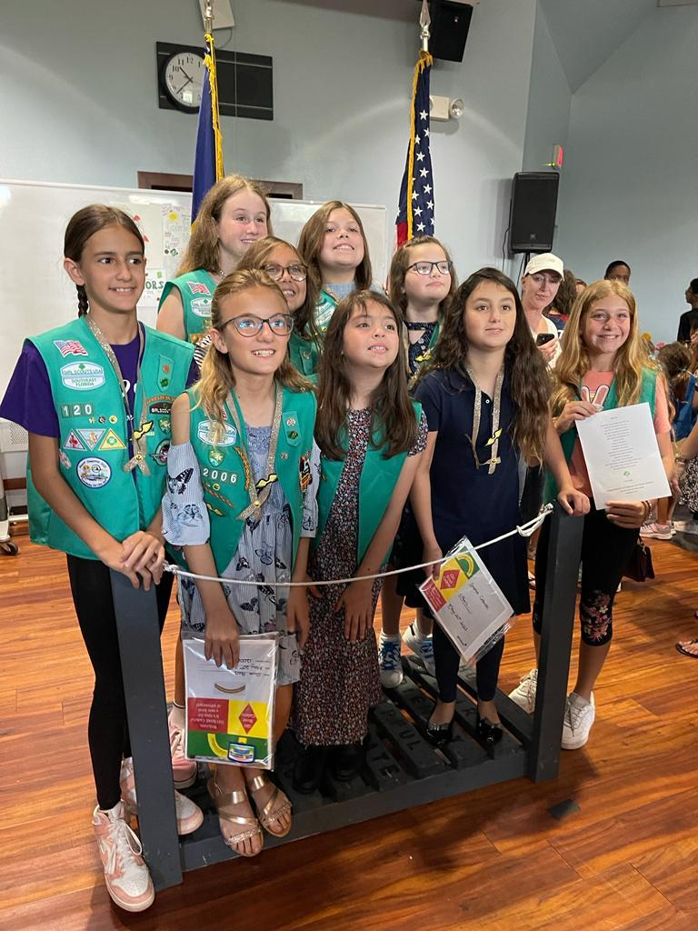
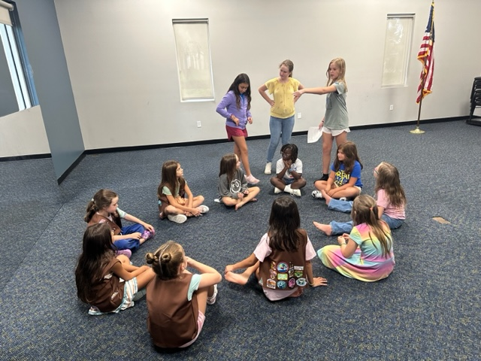
Troop 12006 Bronze award

Slide 2
What is the bronze award?
The Bronze Award is the highest award a Girl Scout Junior can earn. We can earn it by deciding on a problem in our community to fix. We chose Dec My Room for our Bronze Award.

Slide 3
Dec my room
Dec My Room improves the lives of children who have to stay at a hospital for a long amount of time by decorating the rooms that the child is staying in to their liking.
For more information, visit https://decmyroom.org/

Slide 4
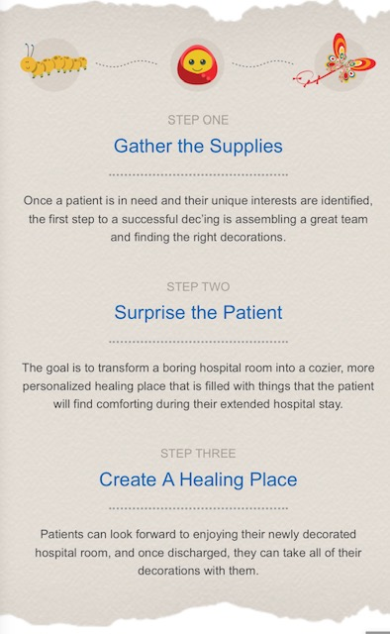
What dec my room is doing

Slide 5
Troop 12006
Troop 12006 decided to pair with Dec My Room for our Bronze Award Project by:
Collecting toys and games for the children in the hospital
Making bags of goodies for the children to play with while getting treatment
Making friendship bracelets
Making fleece blankets
Making hand-made cards with positive notes for different holidays

Slide 6
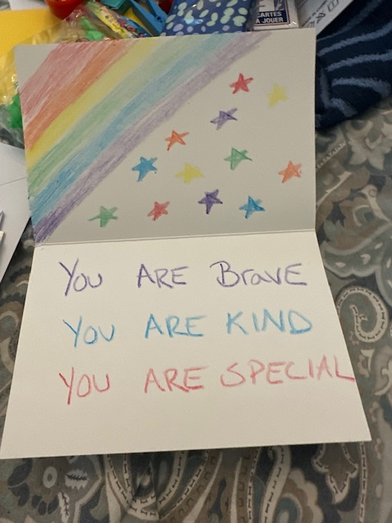
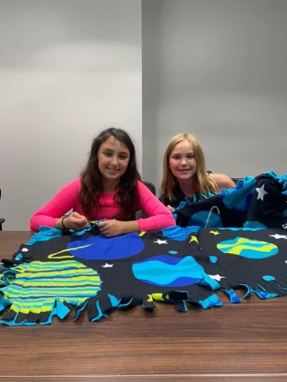
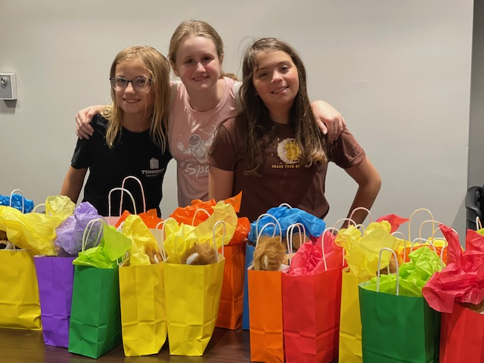

Slide 7
Thank you!
Troop 12006 has been around since some of our members were Daisies.
We started the Bronze Award when we were Juniors.
We have learned lifelong lessons to remember. We also have come a long way from Daisies to Cadettes, and we are so glad that we can help people, the environment, and even ourselves!

